Slide 1
Tuesday, September 27, 2016
Write In Your Agenda:
Write In Your Monitoring Log:
CW:
Plate Tectonics video and video sheet
Boundaries and Faults Quiz
Forces in the Earth’s Crust reading and guided reading sheets.
HW:
None
Response to Warm-Up:
How are ocean plate regions and continental plate regions different?
You will need:
Pencil

Slide 2
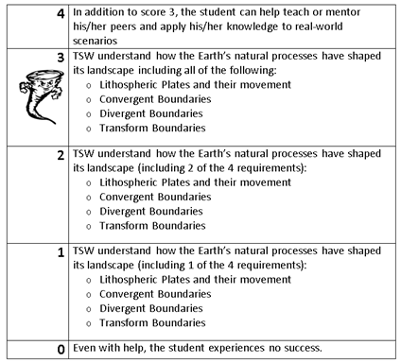
Learning Goal and Scale
TSW understand how the Earth’s natural processes have shaped its landscape (including Lithospheric Plates and their movement, Convergent, Divergent, and Transform boundary landforms).

Slide 3
Take the quiz. Hand in your quiz and privacy folder. Read pages 162-168 and complete guided reading sheets.

